Slide 1

Cultivating Success: Nurturing Growth Through
Innovative Agriculture Management Solutions
Agriculture
Management
System
Anisha Gandhi
Dhir Thacker
Deshna Shah
Prasad Gavas

Slide 2

NEED
Data-Driven Decision-Making
Compliance and Traceability
Productivity Enhancement
Market Access and Farmer Empowerment
Supply Chain Optimization
Climate Change Adaptation
Financial Management
Resource Optimization

Slide 3
Key Stakeholders and Core Entities
03
05
01
Storage Sentinel: Fulfilling Demand Gaps
System Custodian: Administrative Oversight
Agribusiness Hub: Orchestrating Operations
02
04
Cultivator's Console: Empowering Farmers
Customer Nexus: Driving Demand
Farmers hold the reins to update their production in the system, access real-time weather forecasts, and engage with various functionalities to enhance their agricultural pursuits.
Customers take charge of generating orders, steering the demand side of the system and influencing the flow of agricultural products.
The system administrator plays a crucial role in overseeing the entire system, ensuring smooth operations, and maintaining a comprehensive view of the agricultural management landscape.
This entity encompasses enterprises that hire employees, define roles, and play a pivotal role in managing the production flow, including decisions on supplying produce to external entities.
Warehouses act as guardians of supply chains. If a requested item isn't available with the farmer, the request seamlessly moves to the warehouse for fulfillment.

Slide 4
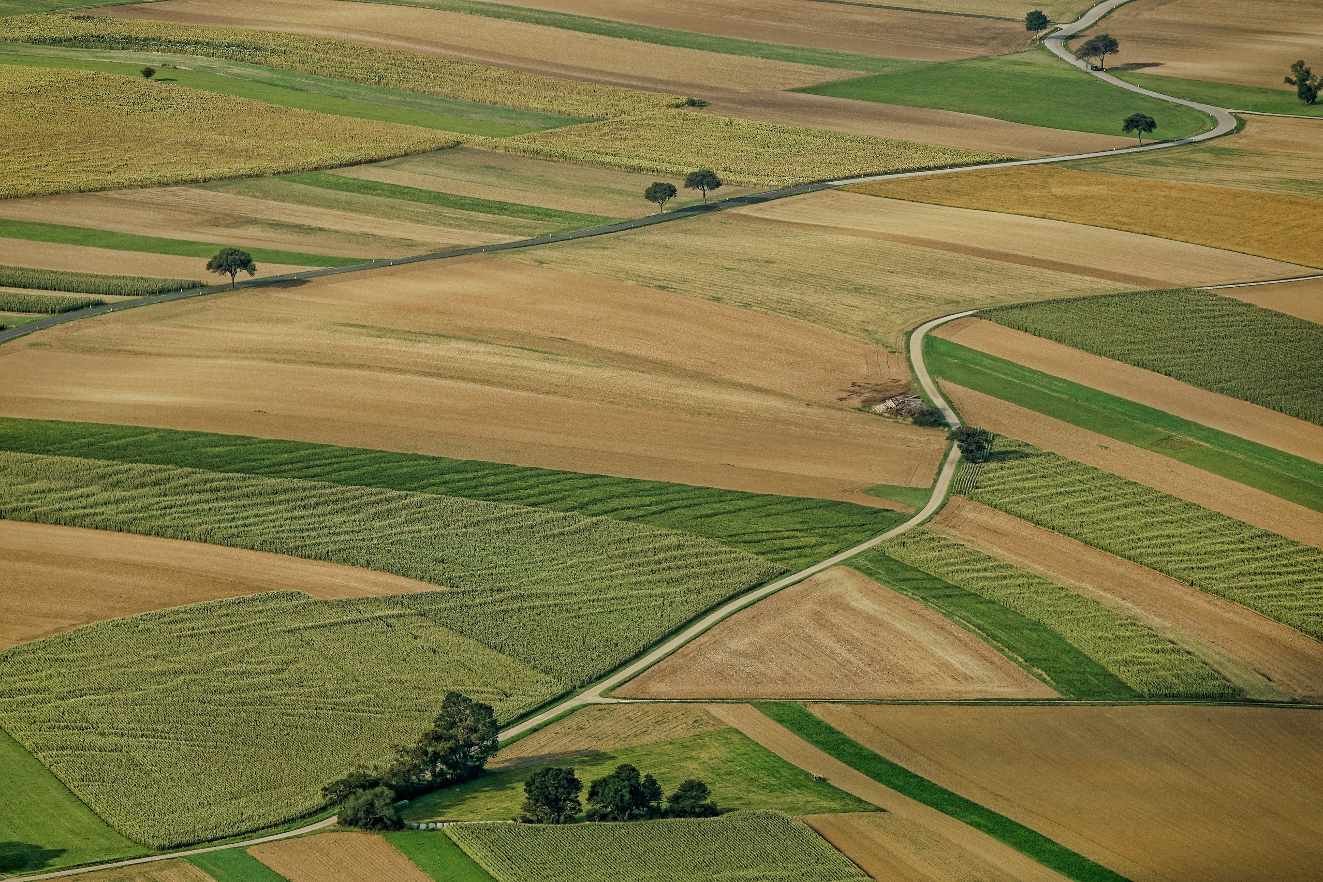
Snapshot of Our User Interface

Slide 5
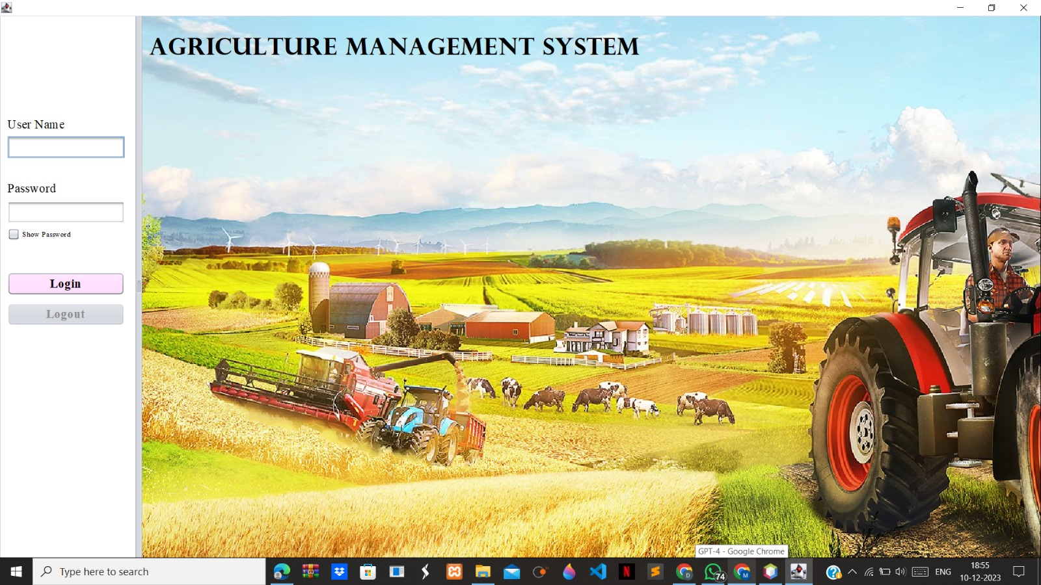
Access Portal

Slide 6
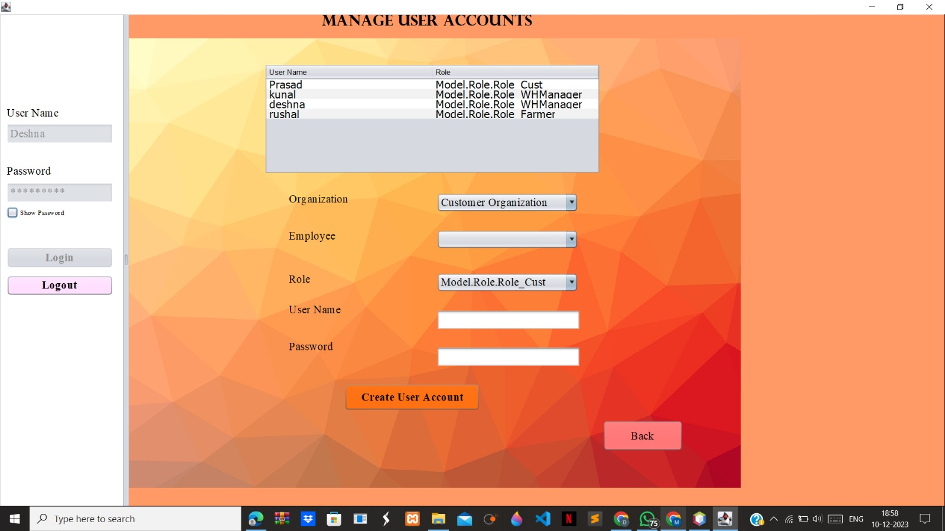
Administer User Profiles

Slide 7
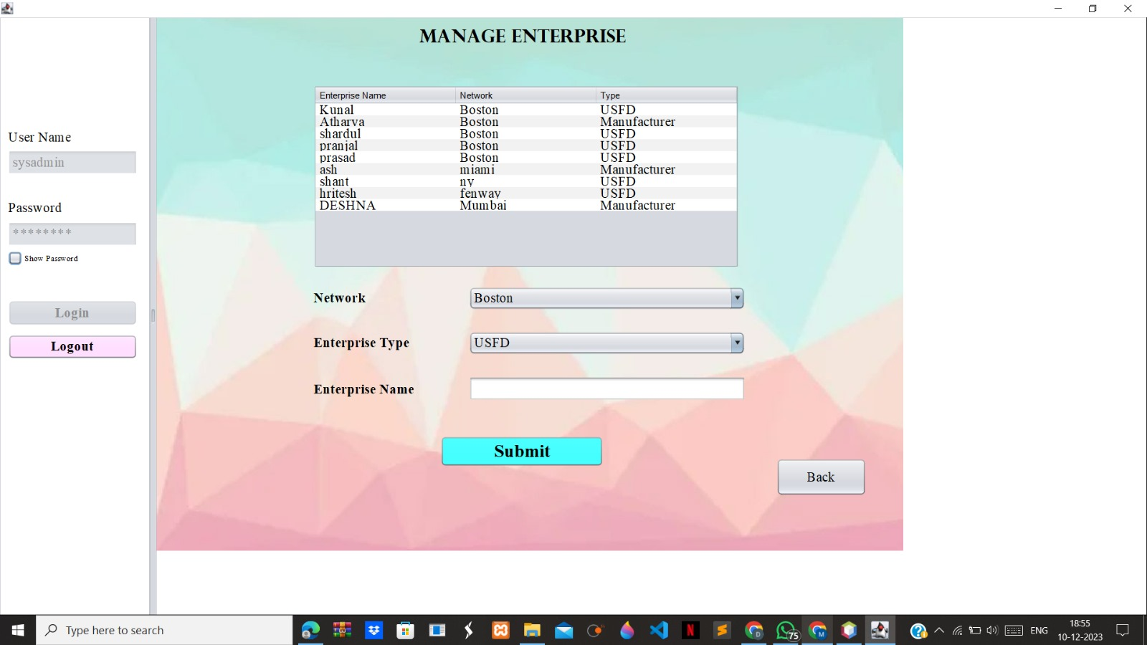
Manage Enterprise

Slide 8
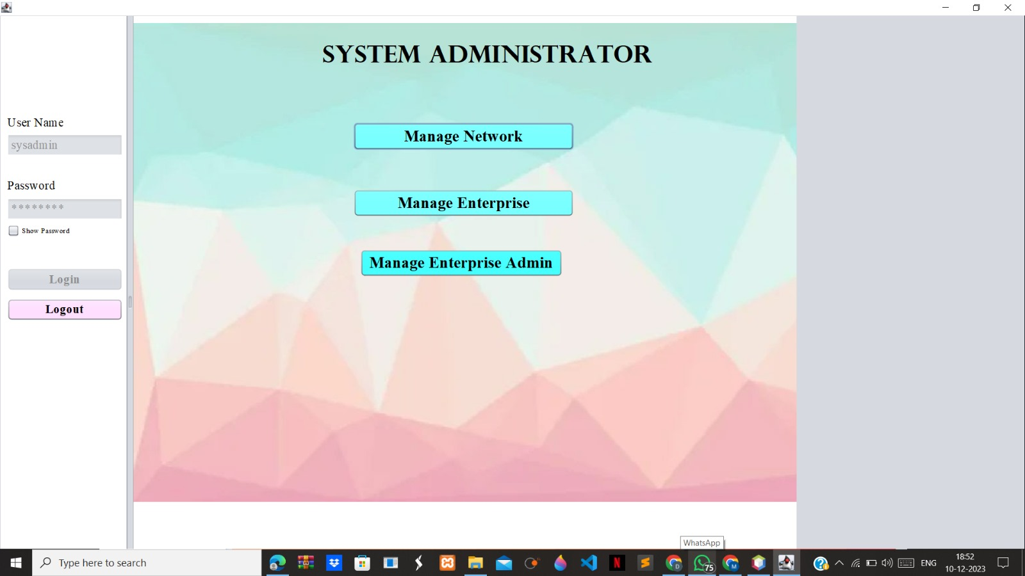
System Admin

Slide 9
Milestone Achieved: Precision in Agriculture Unleashed!
Successful Precision Farming Implementation
- Seamlessly integrated precision farming techniques into our Agriculture Management System.
- Achieved a substantial increase in crop yield through optimized resource utilization.
Key Metrics
- Increased overall productivity by [X]%.
- Reduced resource input while maintaining or enhancing crop quality.
Global Impact
- Positioned our agriculture practices on the forefront of sustainable and efficient farming.
- Recognition from industry leaders for our innovative approach to crop management.
Real-time Weather Integration
- Empowered farmers with instant access to accurate weather forecasts.
- Mitigated risks by enabling timely responses to changing weather conditions.
Enhanced Crop Health Management
- Implemented proactive measures to monitor and manage crop health.
- Resulted in a [X]% reduction in crop diseases and increased overall crop resilience.
Acknowledgments
- Gratitude to our dedicated team for their relentless efforts in achieving this milestone.
- Recognition from agricultural experts and stakeholders for our impactful contribution to modern farming practices.

Slide 10
Thank
You!

